Slide 1
ECE 571 CAN Protocol Controller Design & Verification
By
Vijay E Arputharaj
Akshay S Kotian

Slide 2
INTRODUCTION

Slide 3
CAN Bus
CAN(Controller Area Network) vehicle bus standard allows devices to communicate without host computer
Typical Automobile has around 70 ECU’s so communication requires robust but simple protocol
CAN, developed and patented by Bosch, fills this need

Slide 4
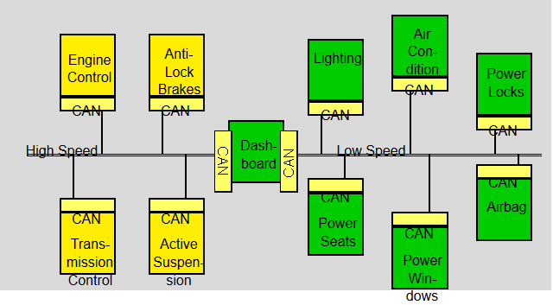
Components
CPU: Host processor decides what messages to send & receive
Controller: Protocol Implementation
Master: Packets, Serializes and transmits on bus
Slave: Stores received bits and hands it over to CPU
Transceiver: Physical layer signaling

Slide 5
Features
CAN is multi-master broadcast serial standard, no limitations on number of devices
Nodes have no specific address and message identifiers are content specific
CRC check for Error Handling, NRZ bit code with stuffing for synchronization
CSMA/BA(Bitwise Arbitration), prioritized arbitration with no loss in time

Slide 6
BASIC CONCEPTS

Slide 7
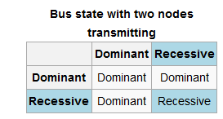
Bus Characteristics
Two Bus states
“1” = Recessive
“0” = Dominant
Bus logic is ‘Wired-AND’ i.e. Dominant bits overwrite Recessive bits

Slide 8
Bus Access and Arbitration
Arbitration is non-destructive and prioritized by message
Bitwise Arbitration scheme
Bits A[3] A[2] A[1] A[0]
Node 1 1
Node 2 1
Node 3 1

Slide 9
Bus Access and Arbitration
Arbitration is non-destructive and prioritized by message
Bitwise Arbitration scheme
Bits A[3] A[2] A[1] A[0]
Node 1 1 0
Node 2 1 0
Node 3 1 1

Slide 10
Bus Access and Arbitration
Arbitration is non-destructive and prioritized by message
Bitwise Arbitration scheme
Bits A[3] A[2] A[1] A[0]
Node 1 1 0 0
Node 2 1 0 1
Node 3 1 1 S

Slide 11
Bus Access and Arbitration
Arbitration is non-destructive and prioritized by message
Bitwise Arbitration scheme
Bits A[3] A[2] A[1] A[0]
Node 1 1 0 0 0 Bus Master!
Node 2 1 0 1 S
Node 3 1 1 S S

Slide 12
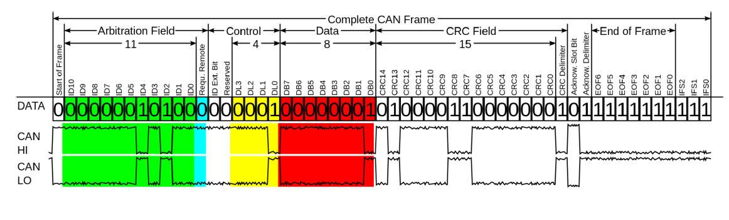
Frame Formats
Data Frame

Slide 13
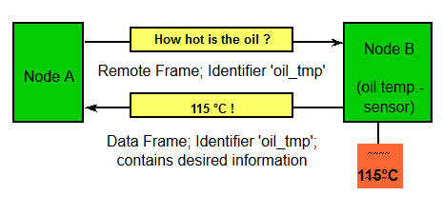
Frame Formats…..
Request Frame
- Similar to Data frame format but no Data field
Error Frame
- Fixed Frame format sent on bus error

Slide 14
CAN Protocol Flow

Slide 15
IMPLEMENTATION

Slide 16
Objective
Synthesizable Behavioral model of CAN Protocol Controller
Use System Verilog constructs for functional verification
Perform Veloce emulation in TBX mode
Designed from scratch , no existing code used

